Slide 1
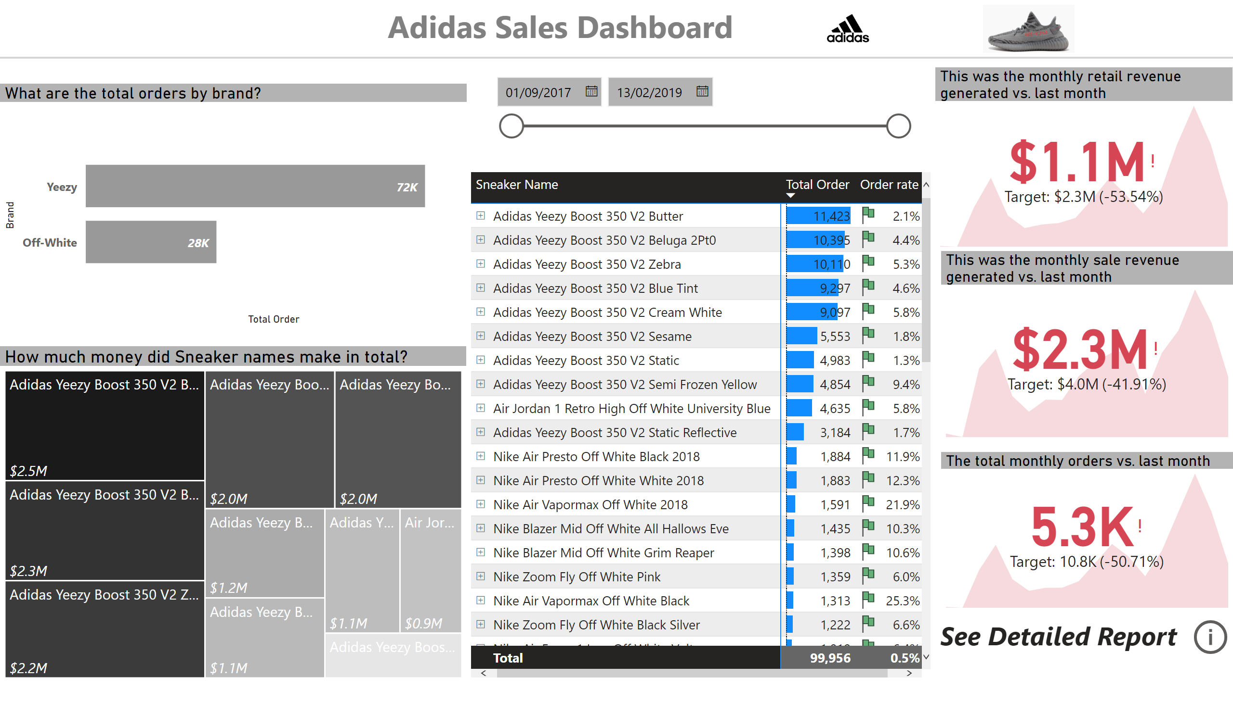
Executive Report
Notes:
textbox
No alt text provided
image
No alt text provided
shape
No alt text provided
How much money did Sneaker names make in total?
No alt text provided
What are the total orders by brand?
No alt text provided
pivotTable
No alt text provided
This was the monthly retail revenue generated vs. last month
No alt text provided
slicer
No alt text provided
This was the monthly sale revenue generated vs. last month
No alt text provided
The total monthly orders vs. last month
No alt text provided
textbox
No alt text provided
actionButton
No alt text provided
image
No alt text provided

Slide 2
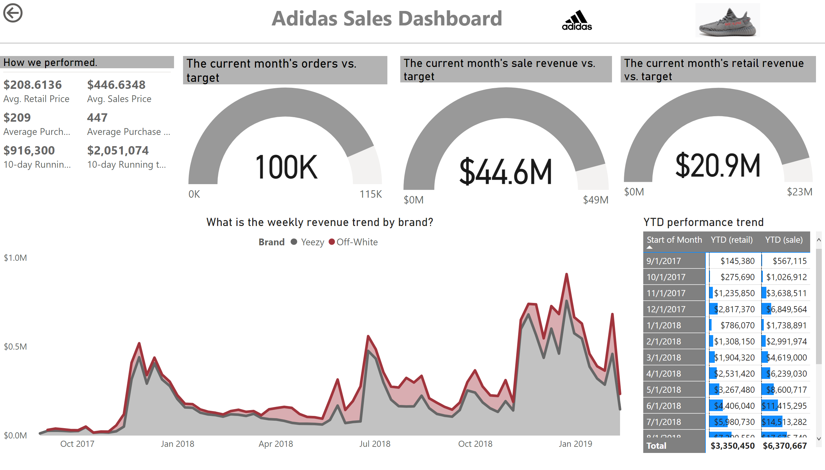
Product Details
Notes:
textbox
No alt text provided
image
No alt text provided
shape
No alt text provided
What is the weekly revenue trend by brand?
No alt text provided
The current month's retail revenue vs. target
No alt text provided
The current month's sale revenue vs. target
No alt text provided
The current month's orders vs. target
No alt text provided
actionButton
No alt text provided
How we performed.
No alt text provided
YTD performance trend
No alt text provided
image
No alt text provided

Slide 3
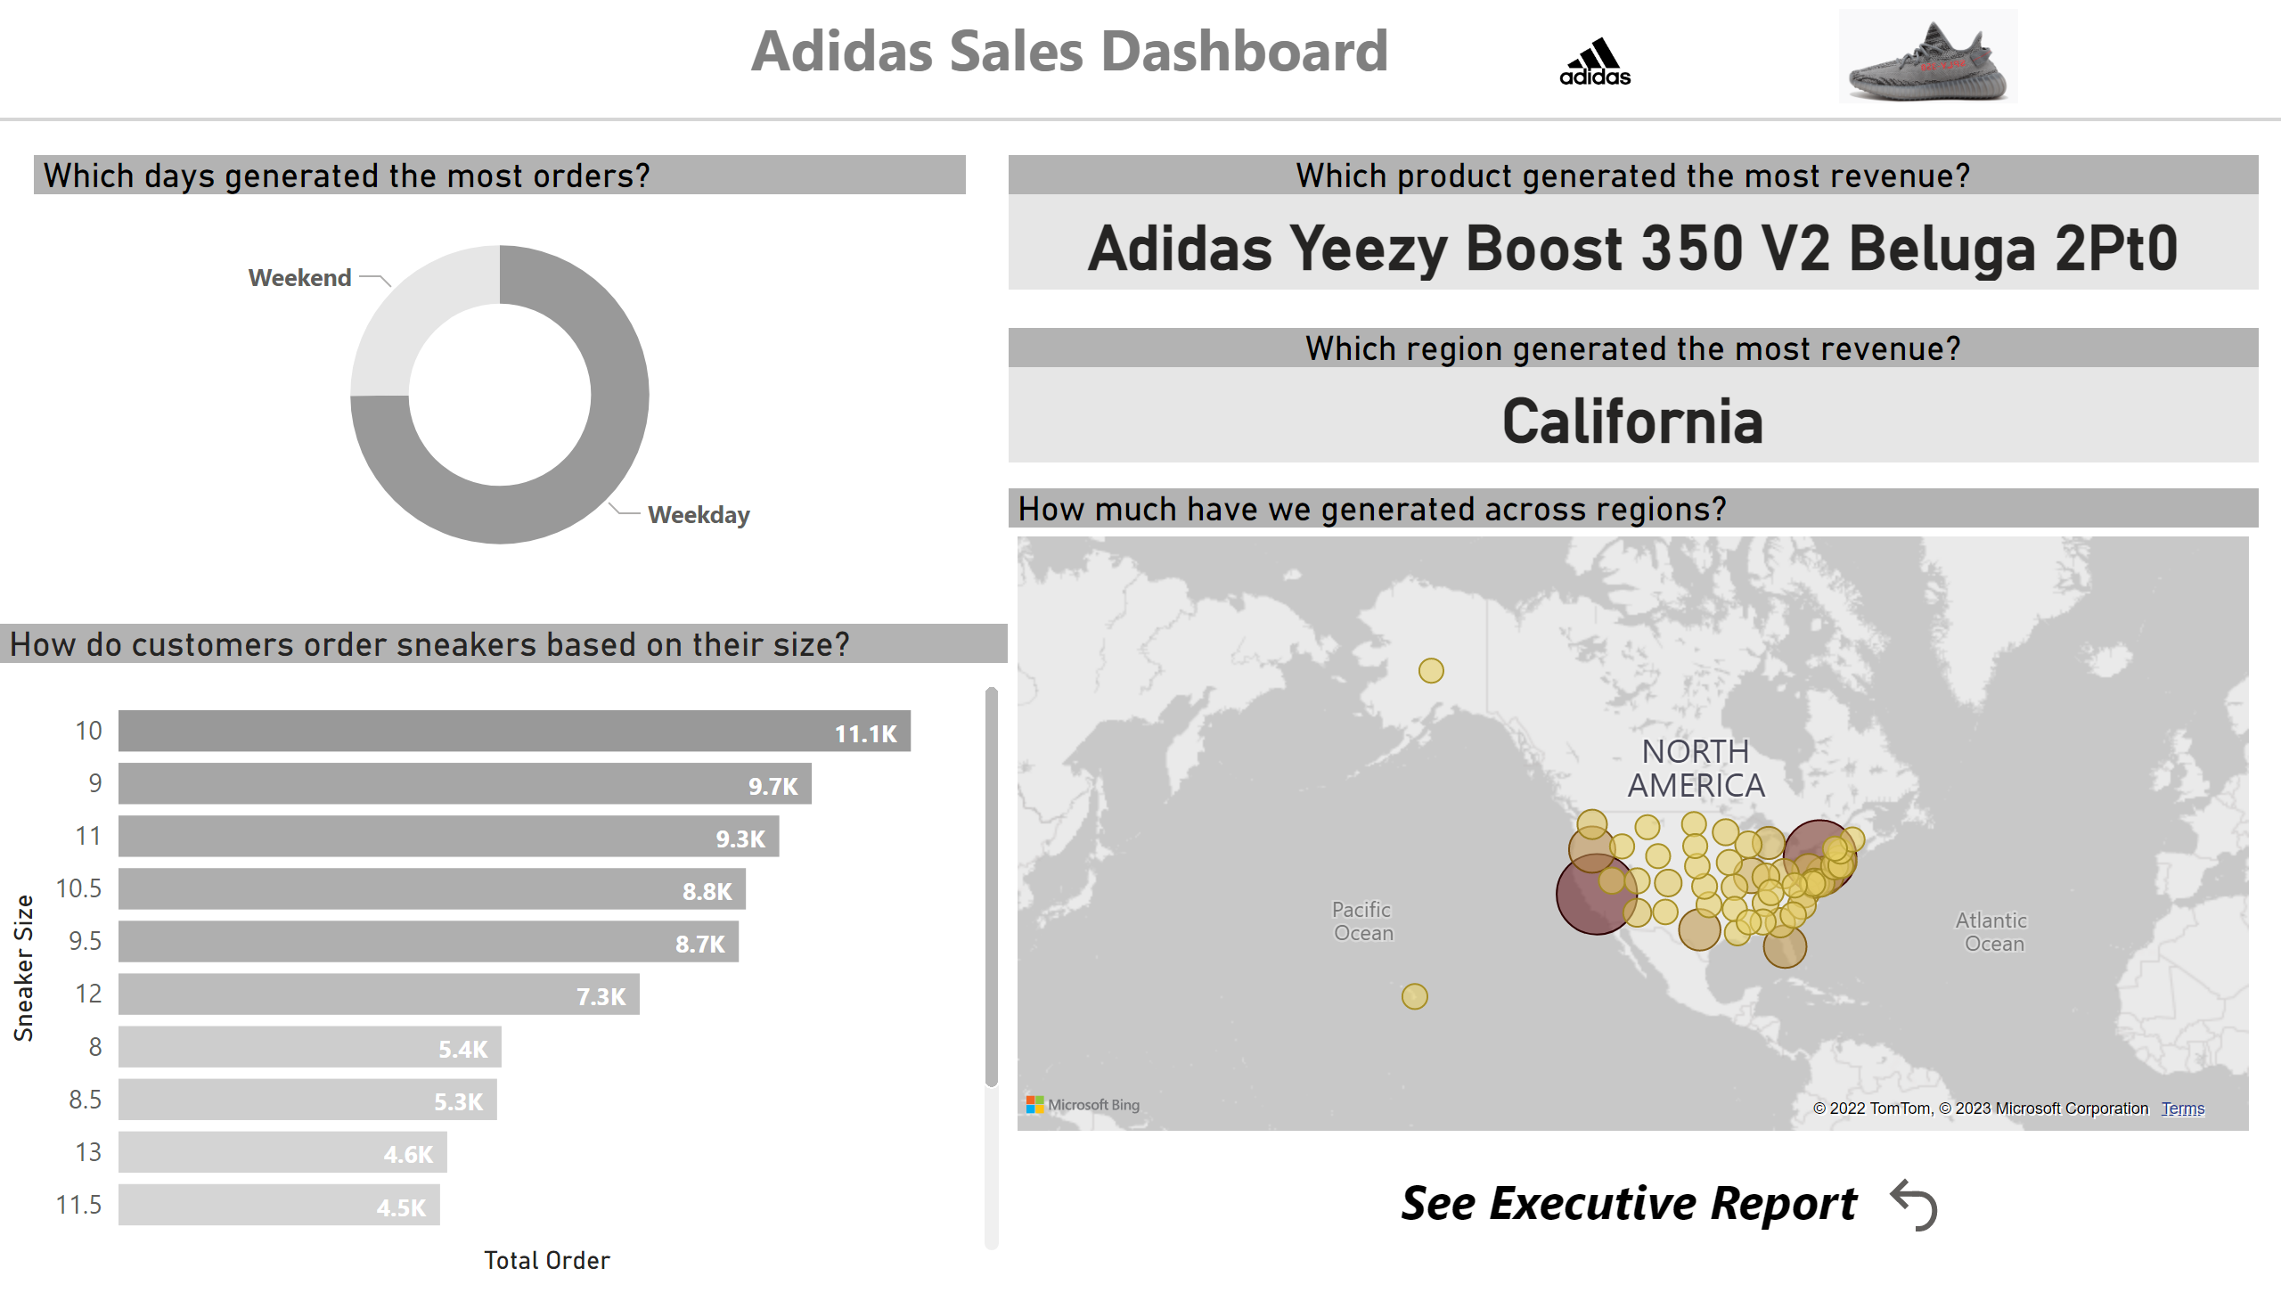
Detailed Report
Notes:
textbox
No alt text provided
image
No alt text provided
shape
No alt text provided
Which days generated the most orders?
No alt text provided
How much have we generated across regions?
No alt text provided
Which product generated the most revenue?
No alt text provided
How do customers order sneakers based on their size?
No alt text provided
Which region generated the most revenue?
No alt text provided
textbox
No alt text provided
actionButton
No alt text provided
image
No alt text provided

